Slide 1
Managing change in organizations

Slide 2

Change management - introduction
What changes?
What is the reason for this change?
How does it change?
Sources: www.anikaa13.blog.interia.pl

Slide 3
Life Cycle Model
Birth
Ageing
Development
Maturity

Slide 4


External and internal forces for change
Changes in the general and task environments (examples):
energy crises
floating currency exchange rates
aggressive policy of other organizations
inflation
new legal acts
Sources: holylandhipster.blogspot.com, www.dz.com.pl

Slide 5
Forces for change
Force | Examples
Human resources | Greater cultural diversity Increase in the number of specialists
Technology | Greater computerization and automation
Economic crises | Stock market crashes Interest rate fluctuations Exchange rate fluctuations

Slide 6
Forces for change
Force | Examples
Competitors | Competitors from all around the world Mergers and concentration of capital
Social trends | Later marriages Increase in the number of divorces
Political environment | War in ……

Slide 7

Force field analysis (Kurt Lewin)
Driving forces:
new technology
better materials
competitors
pressure from superiors
Source: kener.elektr.polsl.pl

Slide 8

Force field analysis (Kurt Lewin)
2. Restraining forces:
group performance standards
fear, sense of insecurity
skills/proficiency
Source: www.raeanticapitalista.com

Slide 9


Understanding resistance to change
Sources of restraining forces:
organizational culture
uncertainty
threatened self-interests
different perceptions
feelings of loss
Attention! People tend to RETURN to old attitudes and behaviors.
Source: www.adent.com.pl, www.ortodonta.com.pl

Slide 10
The Lewin model (Lewin and Schein)
Three steps:
1. Unfreezing
Individuals who will be affected by the impending change must be led to recognize why the change is necessary.

Slide 11
The Lewin model (Lewin and Schein)
Three steps:
2. Implementation of the change itself (transition) (agent of change)

Slide 12
The Lewin model (Lewin and Schein)
Three steps:
3. (Re)freezing
reinforcing and supporting the change so that it becomes a part of the system

Slide 13
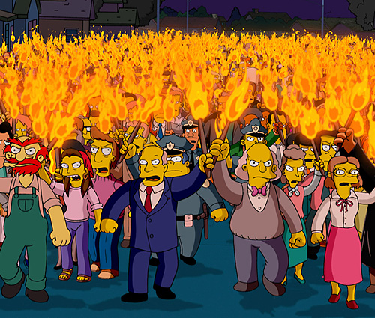
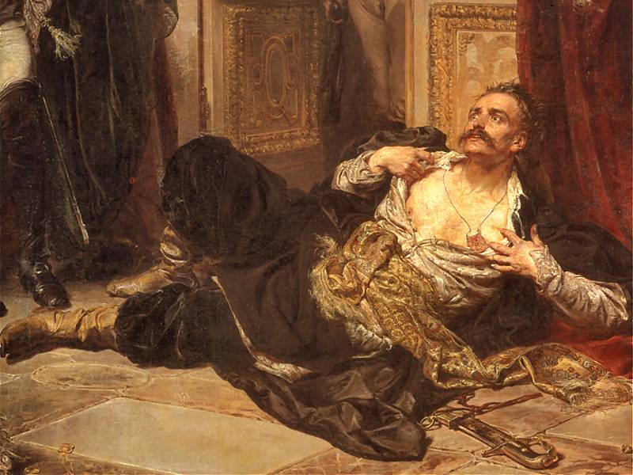
Overcoming Resistance to Change – level I ☺
participation
education and communication
facilitation
force field analysis
Sources: pinakoteka.zascianek.pl, mediaelites.com

Slide 14


Overcoming Resistance to Change – level II …
negotiations
manipulation
extortion
Sources: manipulacja.org.pl, prolog.media.pl

Slide 15
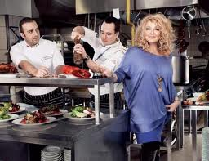
Areas of organization change
organization structure and design
technology and operations
people

Slide 16


Reengineering and kaizen
Reengineering = a major redesign of all areas of an organization
Sources: allgoodphotos.blogspot.com, www.mtgfoundation.com

Slide 17
Reengineering and kaizen
Feature | Kaizen | Reengineering
Effects | Continuous but small | ……………….
Time framework | …………………. | Periodical
Type of changes | Gradual | Dramatic (often revolutionary)
Involvement of people | …………………. | ………………..

Slide 18
Reengineering and kaizen
Feature | Kaizen | Reengineering
Effects | Continuous but small | Big
Time framework | Continuous | Periodical
Type of changes | Gradual | Dramatic (often revolutionary)
Involvement of people | All employees | Chosen groups

Slide 19
Reengineering and kaizen
Attitude | Group effort, systems approach | Individual effort and ideas
Method | Improving and maintaining achieved results | Replacing the old system with a better one
Main concept | Standard know-how and modern technology | ………………….. ……………………

Slide 20
Reengineering and kaizen
Attitude | Group effort, systems approach | Individual effort and ideas
Method | Improving and maintaining achieved results | Replacing the old system with a better one
Main concept | Standard know-how and modern technology | New technologies/ theories

Slide 21
Reengineering and kaizen
Practical requirements | Small investments and big effort to maintain results | Large investments (IT), easy to maintain results
Focus of efforts | Focused on ……………… | Focused on ………………….

Slide 22
Reengineering and kaizen
Practical requirements | Small investments and big effort to maintain results | Large investments (IT), easy to maintain results
Focus of efforts | Focused on People | Focused on Processes and project management

Slide 23
Reengineering and kaizen
Criteria of evaluation | …………………. | ………………….
Advantages | Works well in an evolutionarily developing organization | Works well in a dynamically developing organization or sectors

Slide 24
Reengineering and kaizen
Criteria of evaluation | Process and efforts in order to achieve better results | Results and profits; widespread use of benchmarking
Advantages | Works well in an evolutionarily developing organization | Works well in a dynamically developing organization or sectors

Slide 25
Reengineering - principles
Creating a perfectly cooperating, loyal and partnership (multidisciplinary) based team
A priori assumption that the existing organization is faulty/bad
Problem definition – analysis based on 2 criteria:
- number of intermediaries
- level of cooperation

Slide 26
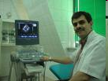
Reengineering – activities
Elimination of processes that
repetitive
Elimination of activities that do not add new values to the procedure
Acting in accordance with the 20/80 rule
Standardization of processes
Sources: www.mastej.pl,
Notes:
.

Slide 27
Reengineering – effects ☺
Significant decrease in employment
Additional profits
Shorter time needed to provide information (both for decision makers and clients)
Improving the level of customer service
Elimination of unnecessary activities and reduction of delays
Increased flexibility and effectiveness of the organization

Slide 28



Reengineering – algorithm ☺
Algorithm:
„½ * 2 * 3”
Sources: www.grupahrplus.pl, www.iswinoujscie.pl, www.ssqq.com

Slide 29

Reengineering – barriers
Psychological
Technological
Economic
Legal
Source: majusek.fm.interia.pl,

Slide 30
Reengineering support methods
Lean management
Outsourcing
Total Quality Management (TQM)
Benchmarking
Just-In-Time (JiT)
Computer decision support systems (CDSS) ☺

Slide 31
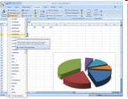

Reengineering – causes of failure ☹
People generally are afraid and resist change
Errors in the process of building the reengineering team
Tradition and habits
Sources:www.takepart.com, www.centrumxp.pl

Slide 32
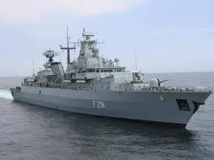

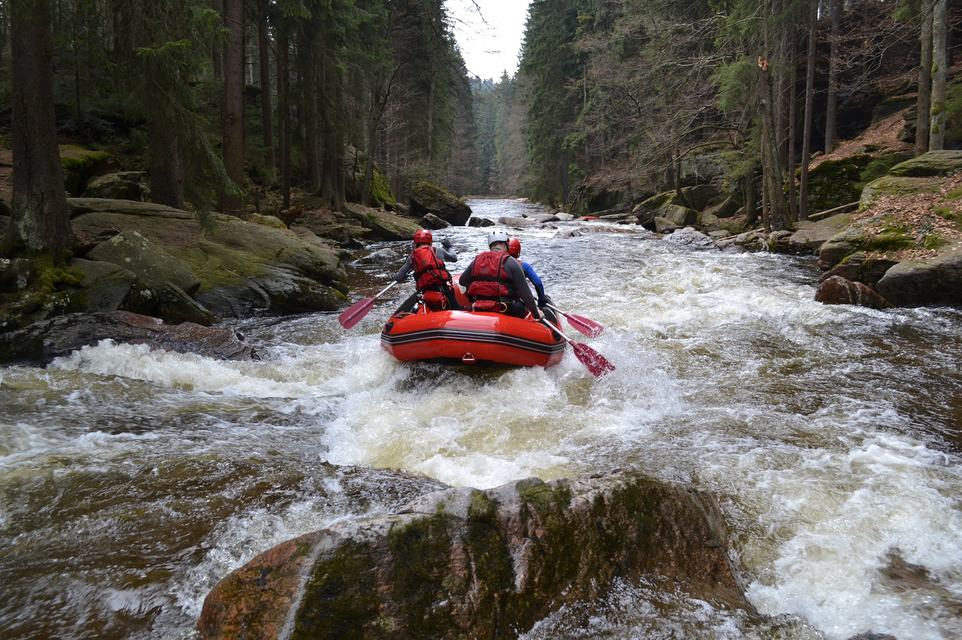
Changes
???
Sources: http://www.ops.mil.pl/op/czytelnia/?aid=99&nd=2008&nid=401, student.ccbcmd.edu, https://www.ski-raft.pl/przystan-ski-raft/szkolenia/49-oferta/lato/dodatkowe-podstrony-kajaki-rafting.html

Slide 33

Changes
Long time ago:
Change = accidental (random) disruption of a predictable world
Now:
Manager’s world = constant and chaotic changes
Managers = eternal agents of change
Source: ektor.nf.pl

